Slide 1
Aims
In this chapter,
As explained that materials may experience two kinds of deformation: elastic and plastic.
Plastic deformation is permanent. Strength and hardness are measures of a material’s resistance to this deformation (hardness measurement).
In crystalline solids, plastic deformation most often involves the motion of dislocations, linear crystalline defects
This chapter discusses the characteristics of dislocations and their involvement in plastic deformation.
Twinning, several techniques are presented for strengthening single-phase metals, the mechanisms of which are described in terms of dislocations.
Finally, recovery and recrystallization—processes that occur in plastically deformed metals, normally at elevated temperatures—and, in addition, grain growth.

Slide 2
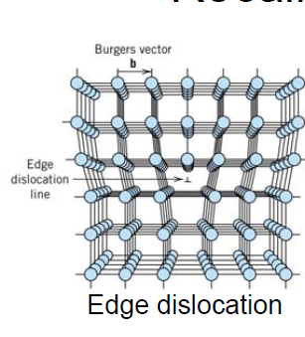
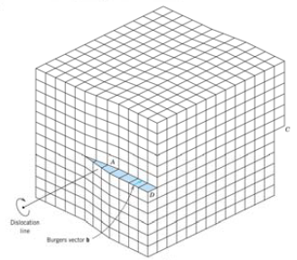
The mechanical strengths could be explained by a type of linear crystalline defect that has since come to be known as a dislocation. (1930s)
RECALL DISLOCATIONS
Screw dislocation
Plastic deformation corresponds to motion of dislocations!

Slide 3
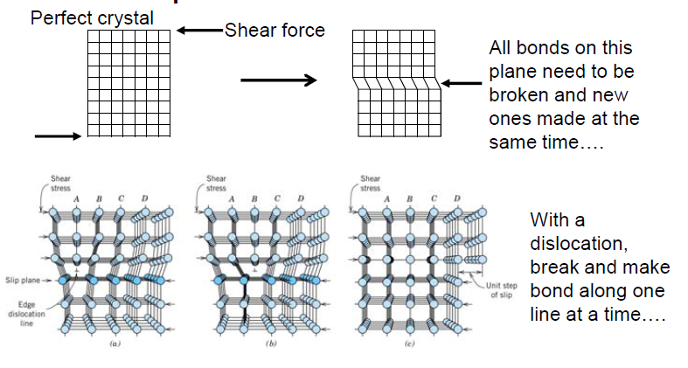
Why are dislocations important in plastic deformation?
Notes:
An edge dislocation moves in response to a shear stress applied in a direction
perpendicular to its line; the mechanics of dislocation motion are represented.
This process is subsequently repeated for the other planes, such that the extra half-plane,
by discrete steps, moves from left to right by successive and repeated breaking of bonds and shifting by interatomic distances of upper half-planes.
Ultimately this extra half-plane may emerge from the right surface of the crystal, forming an edge that is one atomic
distance wide.

Slide 4
Macroscopic plastic deformation simply corresponds to permanent deformation that results from the movement of dislocations, or slip, in response to an applied shear stress.

Slide 5
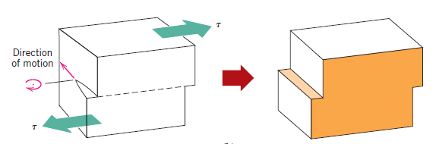
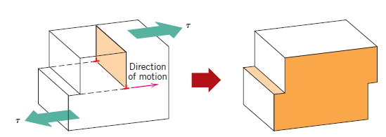
The motion of a screw dislocation in response to the applied shear stress:
the direction of movement is perpendicular to the stress direction.
For an edge, motion is parallel to the shear stress.
However, the net plastic deformation for the motion of both dislocation types is the same.

Slide 6
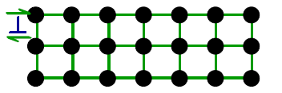
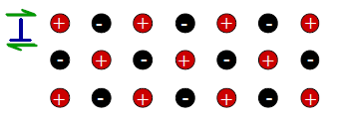
Why mainly in metals and not other materials?
Metals:
- Disl. motion easier.
- non-directional bonding
- close-packed directions for slip
- dislocation density ~ 10³ mm⁻² (carefully solidified metal crystal) to 10¹⁰ mm⁻²( deformed metal)
Covalent Ceramics
- (Si, diamond): Motion hard.
- directional (angular) bonding.
- Disl. density ~ 0.1 to 1 mm⁻² for single crystal Si
Ionic Ceramics:
- Motion hard.
-need to avoid ++ and -- neighbors.
-dislocation density ~ 10² to 10⁴ mm⁻².

Slide 7
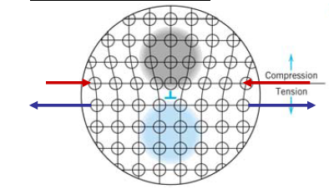
CHARACTERISTICS OF DISLOCATIONS
When metals are plastically deformed, some fraction of the deformation energy (approximately 5%) is retained internally; the remainder is dissipated as heat.
The major portion of this stored energy is as strain energy associated with dislocations.
Edge dislocation:
Screw dislocation:
Pure shear strain.
there are regions in which compressive,
tensile, and shear lattice strains are imposed on the neighboring atoms

Slide 8
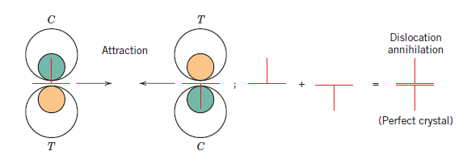
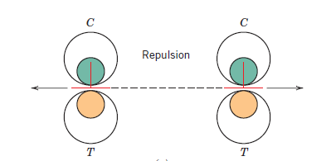
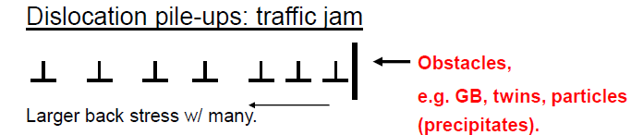
Interacting Edge Dislocations
Edge dislocations of opposite sign and lying on the same slip plane exert an attractive force on each other. Upon meeting, they annihilate each other and leave a region of perfect crystal.
Two edge dislocations of the same sign and lying on the same slip plane exert a repulsive force on each other; C and T denote compression and tensile regions, respectively.

Slide 9
SLIP SYSTEMS
Dislocations do not move with the same degree of ease on all crystallographic planes of atoms and in all crystallographic directions
Ordinarily there is a preferred plane, and in that plane there are specific directions along which dislocation motion occurs.
This plane is called the slip plane; it follows that the direction of movement is called the slip direction.
slip system= slip plane+slip direction
The slip system depends on the crystal structure of the metal
For a particular crystal structure, the slip plane is the plane that has the most dense atomic packing

Slide 10
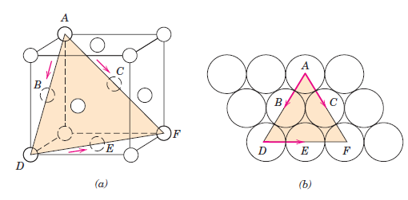
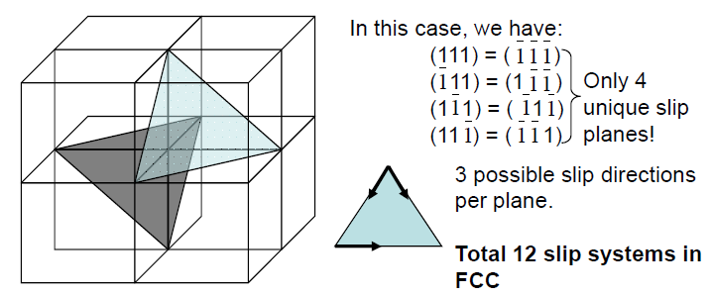
SLIP SYSTEMS
e.g.: Slip in FCC
(a) A {111} <110> slip system shown within an FCC unit cell. (b) The (111) plane from (a) and three <110> slip directions
There are equivalent planes and directions (i.e. families).
Therefore the actual slip system = {111}<110>

Slide 11
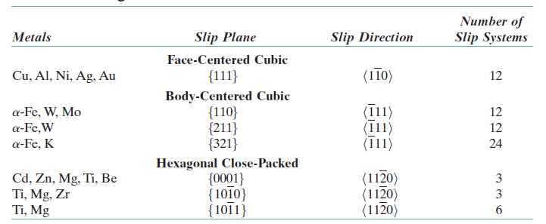
Slip Systems for Face-Centered Cubic, Body-Centered Cubic, and Hexagonal Close-Packed Metals
Many more slip systems than HCP.
FCC and BCC are typically more ductile than HCP.

Slide 12
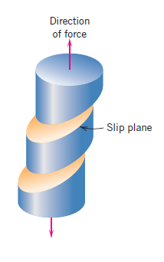
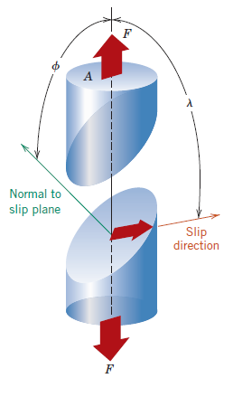
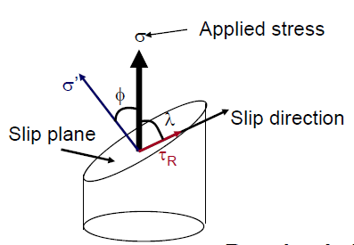
SLIP IN SINGLE CRYSTALS
shear stresses applied along a slip plane and in a slip direction => edge, screw, and mixed dislocations movement
Even with pure tensile stress, shear component may also exist
Resolved shear stresses (τ_{R}) = F (the applied stress, the orientation of the slip plane and direction)
Ø = the angle between the normal to the slip plane and the applied stress direction,
λ = the angle between the slip and
stress directions

Slide 13
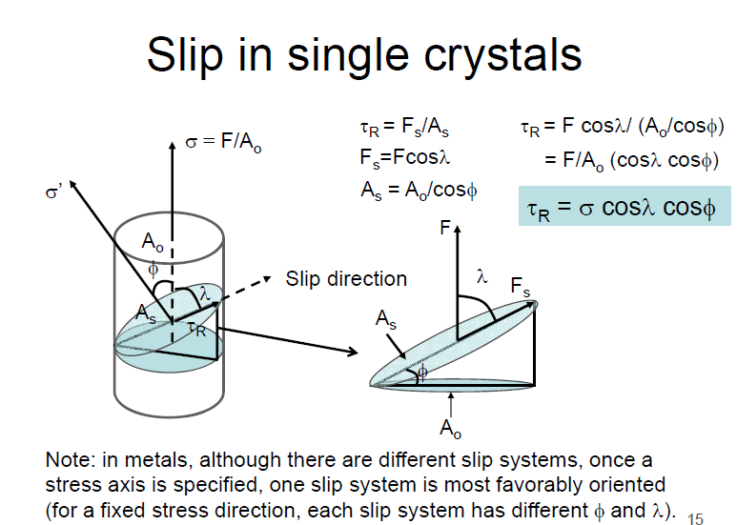
SLIP IN SINGLE CRYSTALS

Slide 14
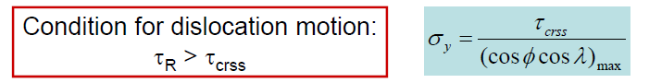
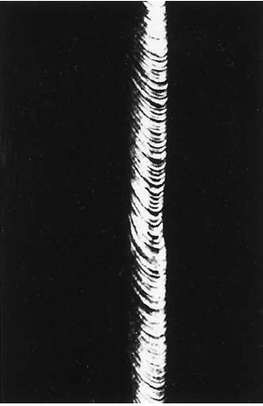
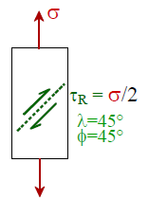
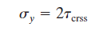
SLIP IN SINGLE CRYSTALS
Critical resolved shear stress (τcrss): minimum shear stress required to initiate slip: This is when yielding begins (i.e. yield strength,σy).
The minimum stress necessary to introduce yielding occurs when a single crystal is
oriented such that Ø=λ=45° under these conditions
Slip in a zinc single crystal

Slide 15
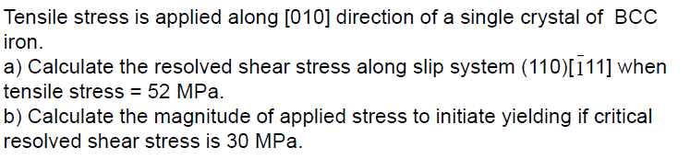
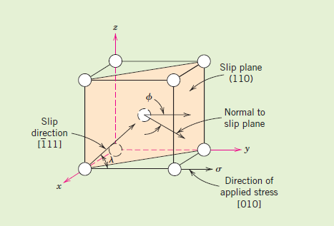
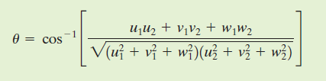
EXAMPLE PROBLEM: Resolved Shear Stress and Stress-to-Initiate-Yielding Computations
Solution
Angle ϴ between directions 1 and 2, represented by [u1v1w1] and [u2v2w2], respectively, is equal to
Ø is the angle between the normal to the (110) slip plane (i.e., the [110] direction) and the [010] direction,
λ represents the angle between the [111]and [010] directions.

Slide 16
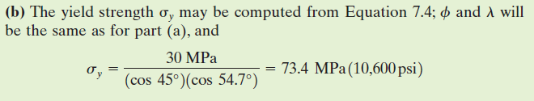
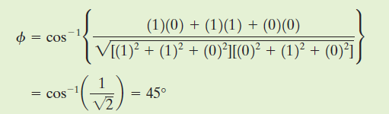
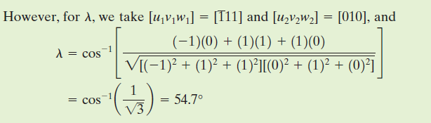
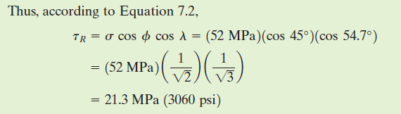
EXAMPLE PROBLEM: Resolved Shear Stress and Stress-to-Initiate-Yielding Computations
Solution

Slide 17
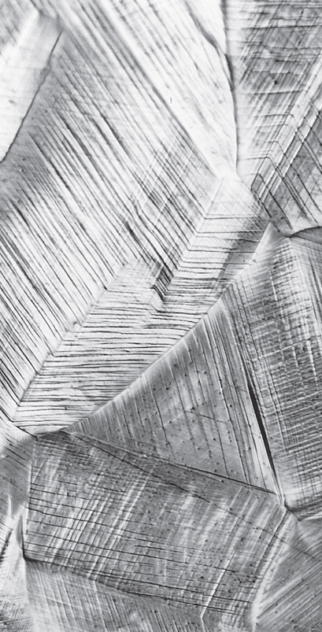
PLASTIC DEFORMATION OF POLYCRYSTALLINE MATERIALS
More complex then single crystals: direction of slip varies from grain to grain due to random crystallographic orientation.
For each, dislocation motion occurs along the slip system that has the most favorable orientation
Slip lines on the surface of a polycrystalline specimen of copper that was polished and subsequently deformed
Slip lines are visible,
it appears that two slip systems operated for most of the grains, as evidenced by two sets of parallel yet intersecting sets of lines

Slide 18
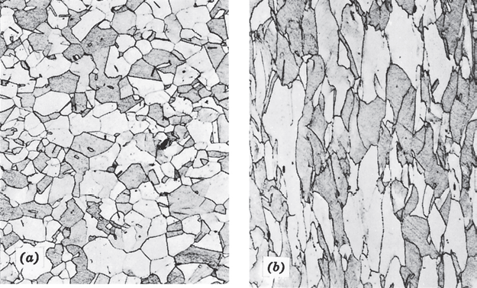
PLASTIC DEFORMATION OF POLYCRYSTALLINE MATERIALS
Alteration of the grain structure of a polycrystalline metal as a result of plastic deformation
(a) Before deformation the grains are equiaxed.
(b) The deformation has
produced elongated grains
Grains elongate in the direction of stress but grain boundaries remain intact.

Slide 19
Mechanisms of Strengthening in Metals
Because macroscopic plastic deformation corresponds to the motion of large numbers of dislocations, the ability of a metal to plastically deform depends on the ability of dislocations to move.
hardness and strength (both yield and tensile) ≈plastic deformation
the mobility of dislocations ↓, the mechanical strength ↑
Virtually all strengthening techniques rely on this simple principle:
Restricting or hindering dislocation motion renders a material harder and stronger.
Strengthening mechanisms for single-phase metals
grain size reduction
solid-solution alloying
precipitation strengthening
strain hardening (cold working)

Slide 20
Mechanisms of Strengthening in Metals
STRENGTHENING BY GRAIN SIZE REDUCTION
Mechanical properties =f(grain size)
Grain boundaries are barriers to slip.
Smaller grain size: more barriers to slip
Grain size may be controlled by solidification process and by plastic deformation followed by appropriate heat treatment.
The motion of a dislocation as it encounters a grain boundary, illustrating how the boundary acts as a barrier to continued slip. Slip planes are discontinuous and change directions across the boundary

Slide 21
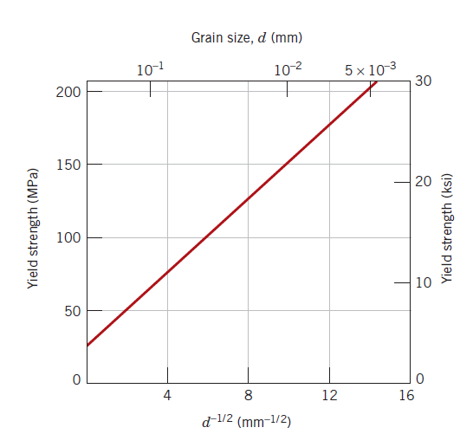
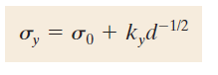
Mechanisms of Strengthening in Metals
STRENGTHENING BY GRAIN SIZE REDUCTION
“A fine-grained material (one that has small grains) is harder and stronger than one that is coarse grained”
Hall–Petch equation: dependence of yield strength on grain size
d : the average grain diameter
σ₀ and k_{y} : constants for a particular material
not valid for both very large (i.e., coarse) grain and extremely fine grain polycrystalline
materials!!!
The influence of grain size on the yield strength of a 70 Cu–30 Zn brass alloy.

Slide 22
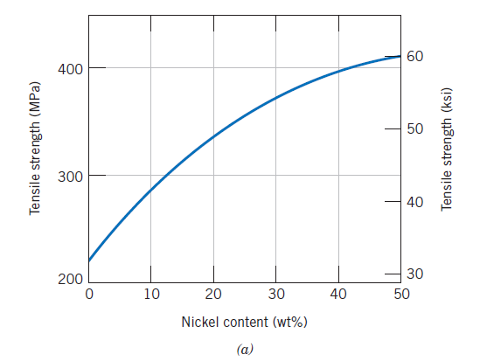
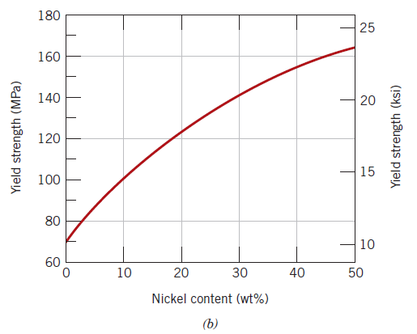
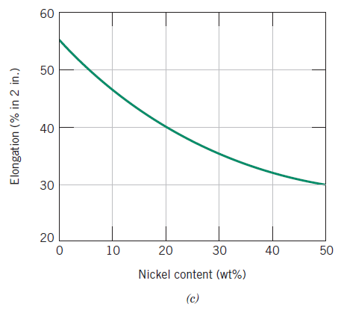
Mechanisms of Strengthening in Metals
SOLID-SOLUTION STRENGTHENING
alloying with impurity atoms that go into either substitutional or interstitial solid solution.
High-purity metals are almost always softer and weaker than alloys composed of the same base metal.
Variation with nickel content of (a) tensile strength, (b) yield strength, and (c) ductility (%EL) for copper–nickel alloys, showing strengthening

Slide 23
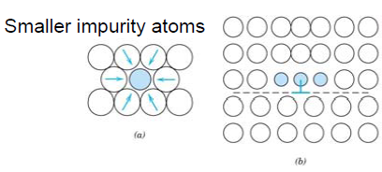
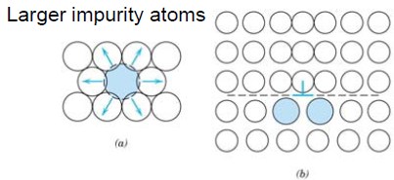
Mechanisms of Strengthening in Metals
SOLID-SOLUTION STRENGTHENING
Alloys are stronger than pure metals.
• Impurity atoms distort the lattice & generate stress.
• Stress can produce a barrier to dislocation motion.
(a) Representation of tensile lattice strains imposed on host atoms by a smaller substitutional impurity atom. (b) Possible locations of smaller impurity atoms relative to an edge dislocation such that there is partial cancellation of impurity–dislocation lattice strains.
(a) Representation of compressive strains imposed on host atoms by a larger substitutional impurity atom. (b) Possible locations of larger impurity atoms relative to an edge dislocation such that there is partial cancellation of impurity–dislocation lattice
strains.

Slide 24
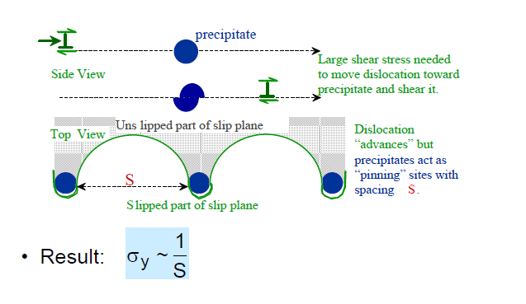
Mechanisms of Strengthening in Metals
PRECIPITATION STRENGTHENING

Slide 25

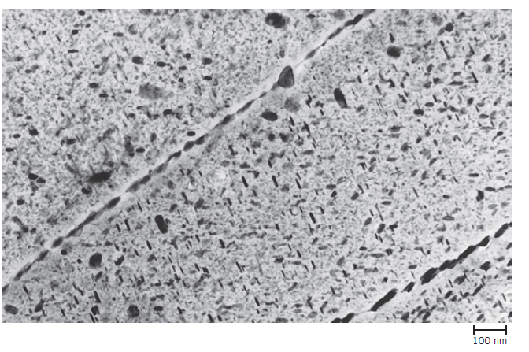
Mechanisms of Strengthening in Metals
PRECIPITATION STRENGTHENING
Example: aluminum alloys used for airplanes
A transmission electron micrograph showing the microstructure of a 7150-T651 aluminum alloy (6.2 Zn, 2.3 Cu, 2.3 Mg, 0.12 Zr, the balance Al) that has been precipitation hardened. The light matrix phase in the micrograph is an aluminum solid solution. The majority of the small plate-shaped dark precipitate particles are a transition ή phase, the remainder being the equilibrium η (MgZn2) phase. Note that grain boundaries are “decorated” by some of these particles. 90,000X.

Slide 26
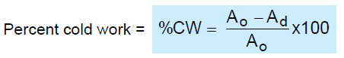
Mechanisms of Strengthening in Metals
STRAIN HARDENING
the phenomenon whereby a ductile metal becomes harder and stronger as it is plastically deformed.
Called cold working because deformation is carried out at a “low” temperature (i.e. below ½ of the melting temperature).
Usually at RT for metals.
Percent cold work— dependence on original (A_{O}) and deformed (A_{d}) crosssectional areas
The dislocation density in a metal increases with deformation or cold work, because of dislocation multiplication or the formation of new dislocations.
the motion of a dislocation is hindered by the presence of other dislocations.
As the dislocation density ↑, this resistance to dislocation motion by other dislocations ↑ => the necessary amount of stress to deform a metal ↑

Slide 27
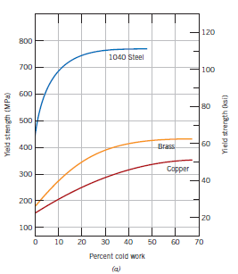
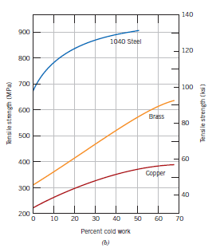
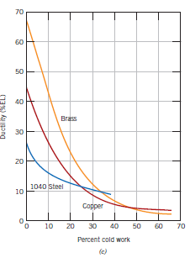
Mechanisms of Strengthening in Metals
STRAIN HARDENING
For 1040 steel, brass, and copper, (a) the increase in yield strength, (b) the increase in tensile strength, and (c) the decrease in ductility (%EL) with percent cold work.
The price for this enhancement of hardness and strength is in the ductility of the metal

Slide 28
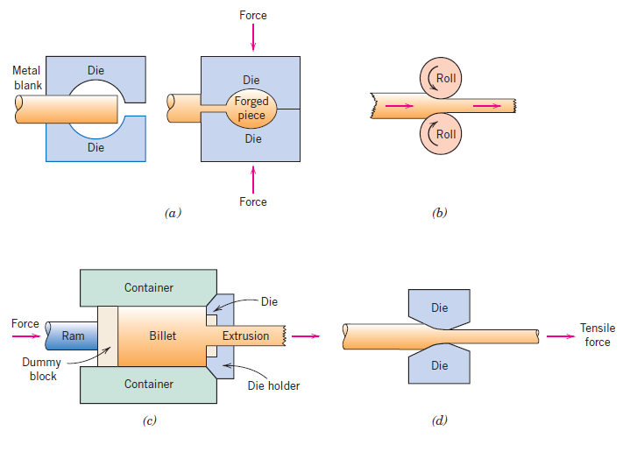
Mechanisms of Strengthening in Metals
STRAIN HARDENING
forging
rolling
extrusion
drawing
Metal deformation during fabrication procedure.
Notes:
Strain hardening is often utilized commercially to enhance the mechanical properties
of metals during fabrication procedures.

Slide 29
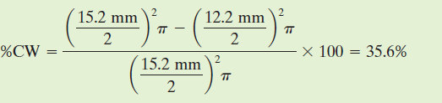
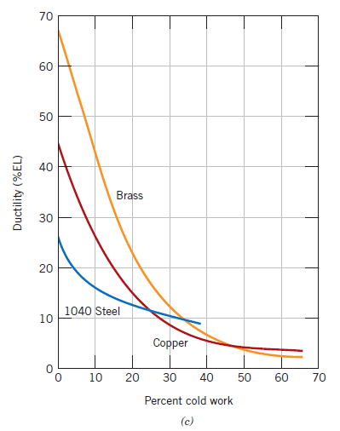
EXAMPLE PROBLEM: Tensile Strength and Ductility Determinations for Cold-Worked Copper
Compute the tensile strength and ductility (%EL) of a cylindrical copper rod if it is cold worked such that the diameter is reduced from 15.2 mm to 12.2 mm
Solution
It is first necessary to determine the percent cold work resulting from the deformation
The tensile strength is read directly from the curve for copper
as 340 MPa.
the ductility at 35.6 % CW is about
7 % EL.

Slide 30
Recovery, Recrystallization, and Grain Growth
Plastically deforming a polycrystalline metal specimen at temperature lower than its melting point produces microstructural and property changes including
changing in grain shape
strain hardening
an increase in dislocation density.
Some fraction of the energy expended in deformation is stored in the metal as strain energy, associated with tensile, compressive, and shear zones around the newly created dislocations
Other properties such as electrical conductivity and corrosion resistance may be modified as a consequence of plastic deformation.
These properties and structures may revert back to the precold-worked states by appropriate heat treatment (sometimes termed an annealing treatment). Such restoration results from two different processes that occur at elevated temperatures: recovery and recrystallization, which may be followed by grain growth.

Slide 31
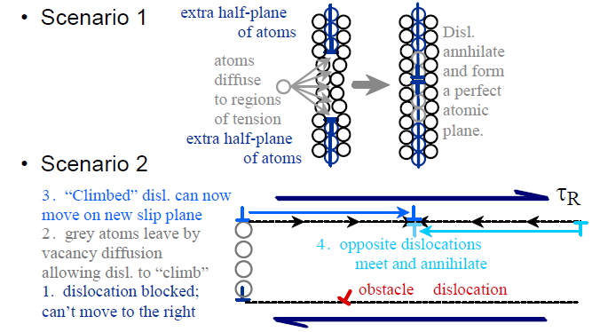
Recovery:
Annihilation reduces dislocation density
at the elevated temperature => enhancement in atomic diffusion =>dislocation motion => relieving of the stored internal strain energy
=> physical properties such as electrical and thermal conductivities are recovered to their precold-worked states.

Slide 32
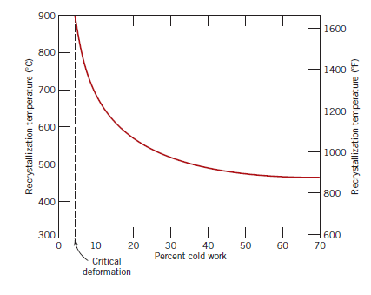
Recrystallization
Even after recovery is complete, the grains are still in a relatively high strain energy
state. Recrystallization is the formation of a new set of strain-free and equiaxed
grains (i.e., having approximately equal dimensions in all directions) having low dislocation densities
New crystals are formed that:
--have a small disl. density
--are small
--consume cold-worked crystals
Recrystallization temperature:f ( the amount of prior cold work and the purity of the alloy)
Recrystallization proceeds more rapidly in pure metals than in alloys.
The variation of recrystallization temperature with
percent cold work for iron. For deformations less than the critical (about 5%CW), recrystallization will not occur.

Slide 33
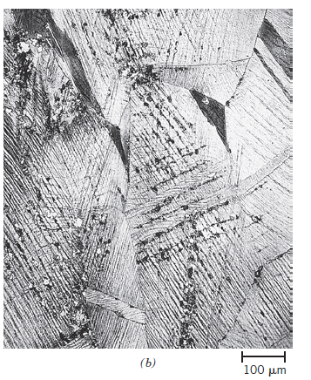



Recrystallization
Photomicrographs showing several stages of the recrystallization and grain growth of brass.
b) Initial stage of recrystallization
after heating 3 s at 580C (1075F); the very small grains are those that have
recrystallized.
(a) Cold-worked (33%CW) grain structure
(c) Partial replacement of cold-worked grains by recrystallized ones (4 s at 580C).
(d) Complete recrystallization (8 s at 580C).

Slide 34

Recrystallization
Recrystallization and Melting Temperatures for Various Metals and Alloys
Generally;
For pure metals: T_{recrystallization} < 0.5×T_{melting}
For alloys: T_{recrystallization} < 0.7×T_{melting}

Slide 35



Grain Growth
After recrystallization is complete, the strain-free grains will continue to grow if the
metal specimen is left at the elevated temperature
Photomicrographs showing several stages of the recrystallization and grain growth of brass.
(e)
(f)
(d)
(d) Complete recrystallization (8 s at 580C). (e) Grain growth after 15 min at 580C. ( f ) Grain growth after 10 min at 700C (1290F).

Slide 36



Grain Growth
For many polycrystalline materials, the grain diameter d varies with time t according to
d₀ : the initial grain diameter at t =0,
K and n : time-independent constants
the value of n is generally equal to or greater than 2.
Schematic representation of grain
growth via atomic diffusion.

Slide 37

Recovery, Recrystallization, and Grain Growth
The influence of annealing temperature (for an annealing time of 1 h) on the tensile strength and ductility of a brass alloy. Grain size as a function of annealing temperature is indicated. Grain structures during Recovery, recrystallization, and grain growth stages are shown schematically.

